Slide 1
Hardware Software Platforms Project Presentation
Tutorial: driving the ADC of the
FPGA board Altera DE1-SoC (rev. D)
Nikola Jovicic : nikola.jovicic@student.umons.ac.be
Quentin Tedeschi :
quentin.tedeschi@student.umons.ac.be
.

Slide 2
Contents
Useful information and requirements
Getting started with the project
Description of the FPGA board
Description of the ADC
Description of the ADC’s driver
Application of the ADC
Testing the application on the board

Slide 3
Useful info. and requirements
Github repo. : https://github.com/njlora/Altera-DE1SoC-ADC
Every code and document (data sheet, user manual and tutorial) are on this repo.
Software : Altera Quartus II v15
Basic requirements : start a new project, compile the code and simulate with « modelsim »

Slide 4
Getting started with the project
Launch Altera Quartus II and create a new project (recognisable name and path) -> « ADC_DE1-SoC »
Select the model of your board
Ready to go !
Codes :
adv_adc.v: Verilog driver
Bouton.vhd: VHDL application
adv_adc_TB.vhd: Testbench of the driver
TB_final.vhd: Testbench of the driver and the application together

Slide 5
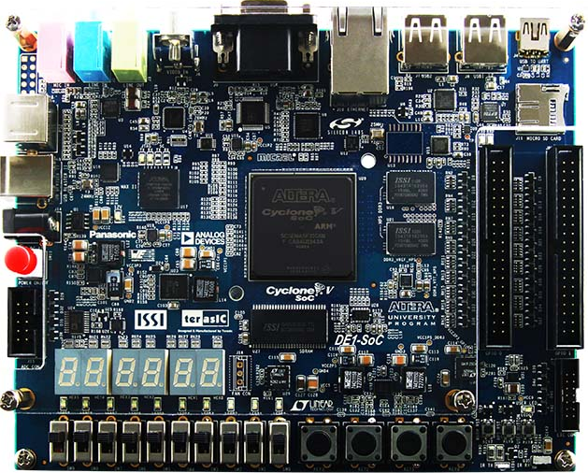
Description of the FPGA board
HEX
display
Power
button
ADC
input
pins
Switches
and
buttons
ADC
Image source: https://rocketboards.org/foswiki/Documentation/
TerasicDE1SoCDevelopmentAndEducationBoard

Slide 6
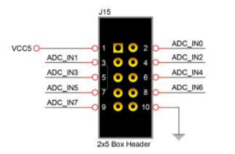
Description of the ADC
8 Analog channels
2 pin for Voltage (5V) and Ground

Slide 7
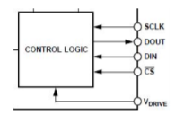
Description of the ADC
One output: DOUT, the result of the operation
Three input: SCLK, CS_N, and DIN

Slide 8
Description of the ADC
DIN contain ADC configuration:
Voltage Range
Coding (binary or complement)
Power Management
Channel Selection

Slide 9
Description of the ADC’s driver (adv_adc.v)
Recover the Verilog driver (IP catalog):
Tools -> IP catalog
Type « ADC » in the search bar
Double on the result that appears
Tab « Block symbol »: representation of the driver
This step is optional and only if you wish to recover the original driver by yourself

Slide 12
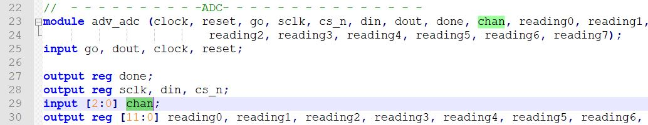
Description of the ADC’s driver (modifications)
Original driver: sweep over all channels (send the information on every channel)
Modded driver: select the channel on which you want to send the data

Slide 13
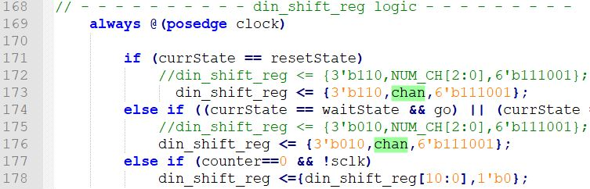
Original code is commented (// before the code)

Slide 14
Description of the ADC’s driver (state machine)
CS_N=0 -> Start converting Analog to Digital
DONE=1 -> All 8 channels have been swept
GO=1 -> ADC sends digital data to driver

Slide 15
ResetState
When RESET is pressed (RESET=1), the driver is in ResetState (CS_N=1,
DONE=0). At positive clock edge (CLOCK @50MHZ), switch to
InitCtrlRegState.

Slide 16
InitCtrlRegState
CS_N=0 (DONE still at 0) and the ADC starts the conversion (Analog to
Digital) by building the 15 bits DOUT vector (see next slide). After 15 clock
counts of ADC_SCLK (12,5 MHZ) and ADC_SCLK=0, switching to WaitState.

Slide 18
WaitState
CS_N=1 (DONE still at 0). The ADC peripheral on the board is ready to send,
bit by bit, the 15 bits DOUT vector on a specific channel to the driver
(ADC_DOUT). If GO=1, switching to TransState.

Slide 20
TransState
CS_N=0 (DONE still at 0). The ADC transmits, bit by bit, the DOUT vector to
ADC_DOUT of the driver (15 bits <-> 15 clock counts). Meanwhile, a new
conversion can start (Analog to Digital) at the same time. After 15 clock
counts of ADC_SCLK, switching to PauseState.

Slide 21
PauseState
CS_N=1 (DONE still at 0). Respect of a time condition between conversions:
t_quiet (at least 50 ns). After 50 ns, switching to TransState and changing
the channel number.
If all channels have been used, switching to DoneState.

Slide 23
DoneState
CS_N=1 and DONE=1. All the channels have been used to send the data.
While GO=1, driver remains in this state. When GO=0, return to ResetState.

Slide 24
Description of the ADC’s driver (simulation results-adv_adc_TB.vhd)

Slide 25
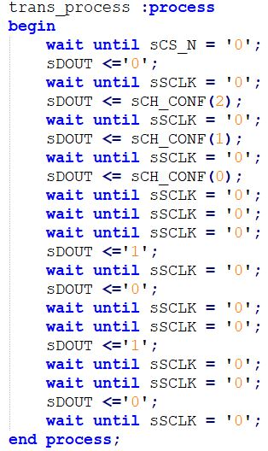
DOUT generation in adv_adc_TB

Slide 26
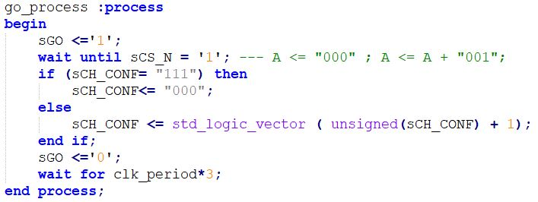
Channel switching in adv_adc_TB

Slide 27
Application of the ADC
We need to define how will the user interact with the ADC
4 buttons and 10 switches on the card
1 LED for each switch; 6 7-segment displays

Slide 28
Interaction with ADC
1 Button for the “Reset”
1 switch for the “GO”
3 switches for channel selection
The corresponding led of each switch is turned on when the switch is on
One 7-segment display shows the number of the current channel in use

Slide 29
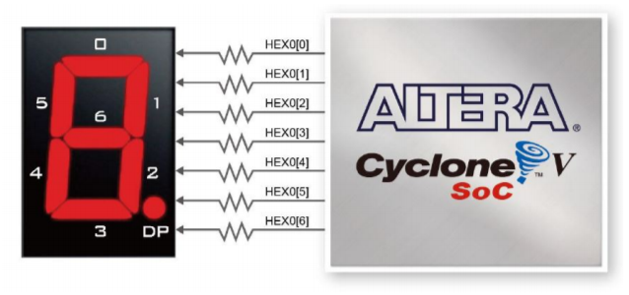
7-Segment Display Coding

Slide 30
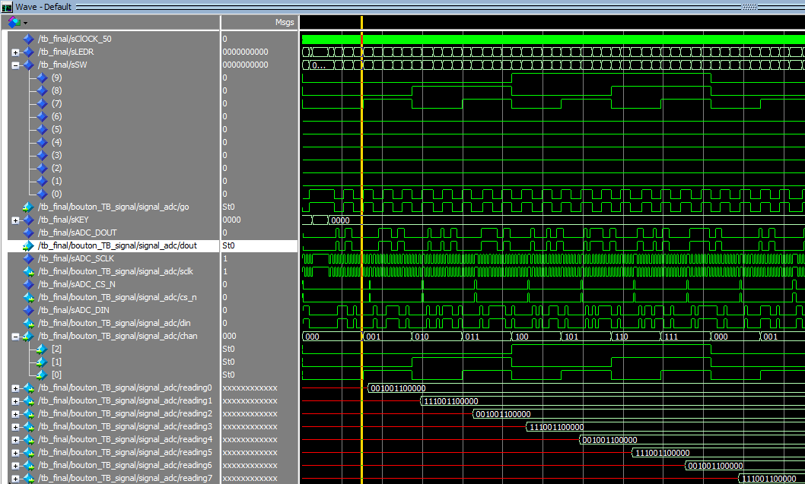
ADC application simulation

Slide 31
Testing the application on the board
Remove all testbenches from the project and keep only « adv_adc.v » and « Bouton.vhd » (recommended).
Compile these 2 files
After compilation, plug the FPGA board into power (with AC adapter) and use « USB Blaster II » connector to connect it to the computer.
Drivers of Quartus II have normally recognized your board.

Slide 32
Testing the application on the board
Tools -> Programmer

Slide 33
Testing the application on the board
If the board is not showing up, click on « Hardware Setup »

Slide 34
Testing the application on the board
Be sure to select « JTAG » mode !!!

Slide 35
Testing the application on the board
Change file of 5CSEMA5 only !!! Look for the .sof file (usually in « output_files »).

Slide 36
Testing the application on the board
Ready to flash ! (Check the chain in the sub-window)

Slide 37
Testing the application on the board (video)
Youtube link: https://youtu.be/aX6UkGxf2ac

Slide 38
Thank you for your attention !
Questions ?

